Slide 1

GetFit
by Team Life

Slide 2

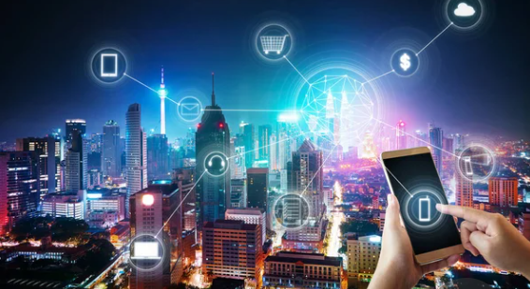
What is GetFit?
An app that encourages and motivates users to adopt a healthier lifestyle
Rewards users the more active they are

Slide 3
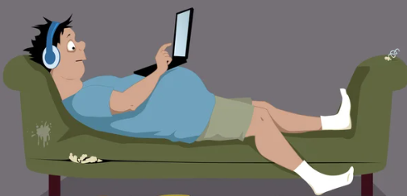
Why the urgency?
67% are less active today ⁽¹⁾
  Filipino youths rank second in the world on physical inactivity⁽²⁾
https://www.rappler.com/brandrap/health-beauty-and-wellness/less-exercise-filipinos-covid-19-pandemic-anlene-survey/
https://newsinfo.inquirer.net/1193821/who-ph-youths-2nd-most-inactive-next-to-s-koreans

Slide 4

The GetFit community
Building a sustainable ecosystem
  Establish a community of health-focused users
  Partner with business merchants deemed to promote a healthier lifestyle

Slide 5

Life coins: the heart of GetFit
Earn life coins on health related activities
  Exercising – pedometer tracking
  Visiting merchants – QR scanning
Use the life coins
  Claim discount vouchers
  Participate in events
  More future offering
Withdraw life coins to wallet

Slide 6
GetFit Architecture
Ethereum
GetFit Initialization
- Minting of life coins
- 2 trillion life coins
2. Sends coin to user wallet
User 1
GetFit Server
ETH
Wallet
ETH
Wallet
1. Sends Withdrawal
Request
GetFit
App
GetFit
DB
GetFit App
- Earn Life Coin
- Use Life Coin
- Withdraw

Slide 7
Demo

Slide 8
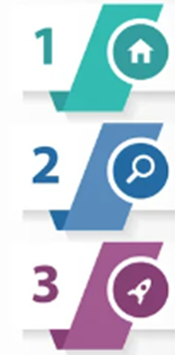
Roadmap
GetFit Initial Rollout – Pedometer, QR scanning
Availability of Life Coin Wallet
Partnership with 3-5 establishments
GetFit – NFT Badges, App challenges
AMM Pool
Increased partnerships – target 5-10
Rollout premium partnerships
GetFit – NFT avatars, social community
Offer cross business rewards program
Partnership with special event organizers

Slide 9
Thank You

Slide 10
Backup Slides

Slide 11
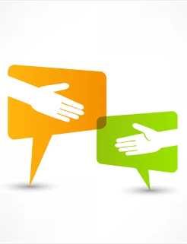
GetFit Benefits
A fun and rewarding experience to stay fit and healthy
Get special offers from merchants aligned with the theme
Sustainable program – Partnership with businesses to develop targeted marketing campaigns to the right audience

Slide 12
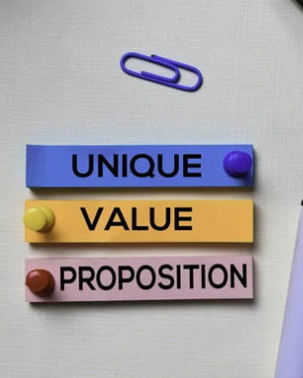
A Unique Value Proposition
Designed with a local setting in mind
Niche segment paves the way towards developing targeted programs and initiatives
Ease of WEB3 onboarding to the non-technical public

